Slide 1
Rainfall Prediction

Slide 2
DATA
145460 rows and 23 features
OBJECTIVE
Build a machine learning model to predict if
there will be rain the next day using weather
conditions of the previous day
BUSINESS CASE
Reduce incorrect prediction of False Negatives for Rain Tomorrow

Slide 3
FEATURES OF DATASET
Date
Location
Daily Minimum Temperature
Daily Maximum Temperature
Daily Rainfall
Daily Evaporation Rate
Daily Amount of Sunshine
Daily Wind Gust Direction
Daily Wind Speed
Daily Morning Wind Direction
Daily Afternoon Wind Direction
Daily Morning Wind Speed
Daily Afternoon Wind Speed
Daily Morning Humidity
Daily Afternoon Humidity
Daily Morning Atmospheric
Pressure
Daily Afternoon Atmospheric
Pressure
Daily Morning Cloud Cover
Daily Afternoon Cloud Cover
Daily Morning Temperature
Daily Afternoon Temperature
Rain Today

Slide 4
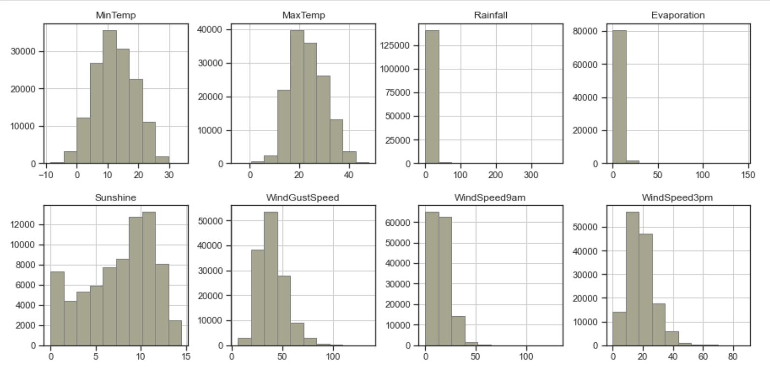
EXPLORATORY DATA ANALYSIS – Numerical Features
Skewness and Outliers observed

Slide 5
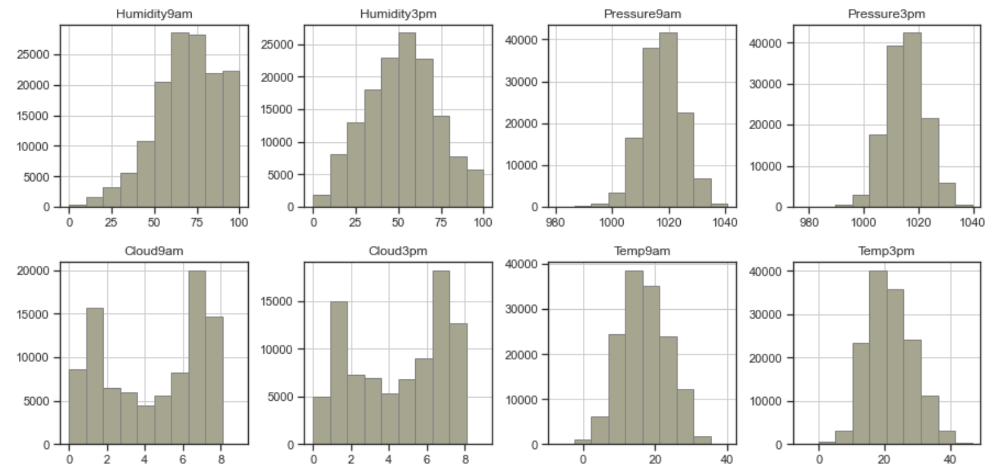
EXPLORATORY DATA ANALYSIS – Numerical Features

Slide 6
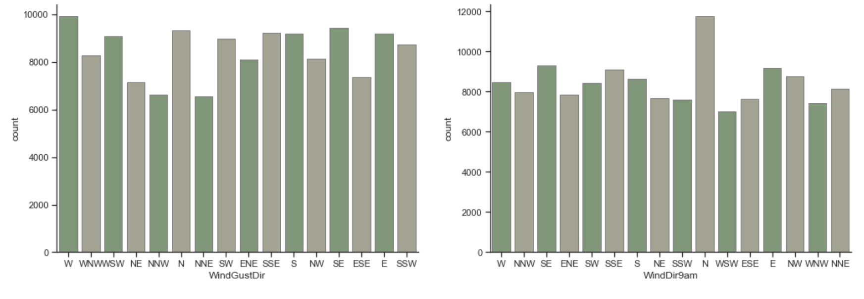
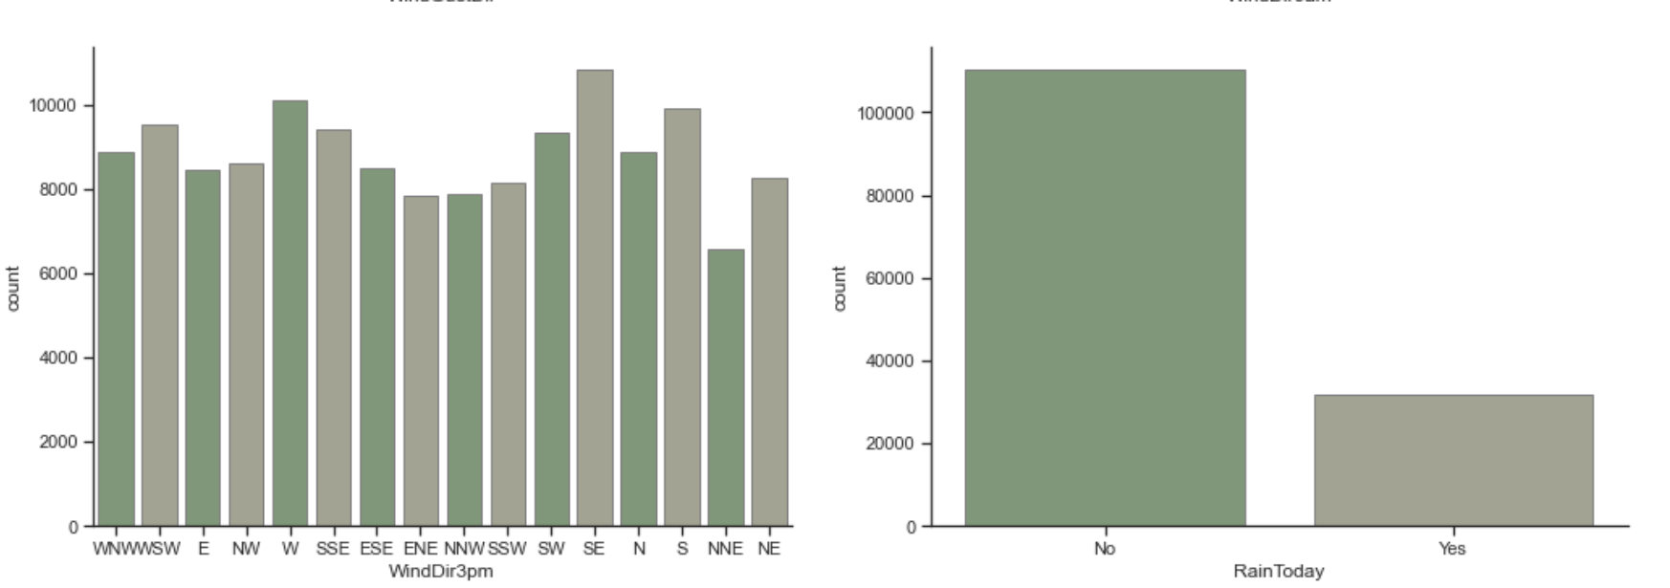
EXPLORATORY DATA ANALYSIS – Categorical Features

Slide 7
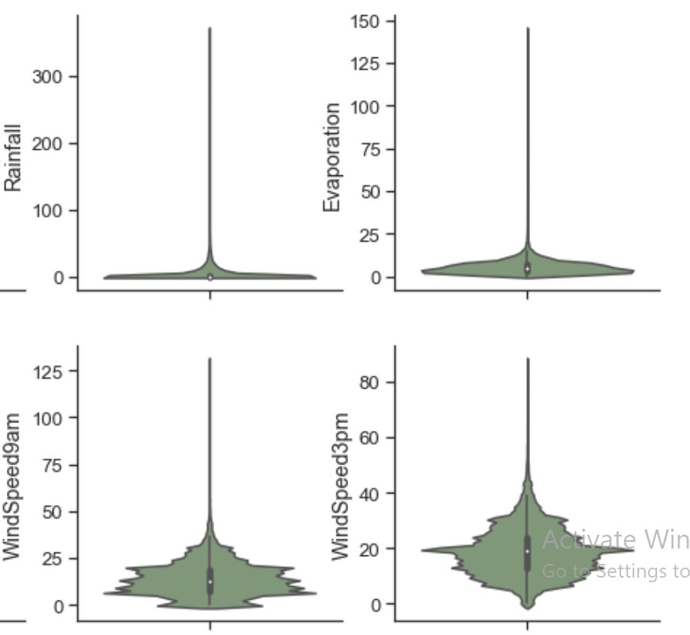
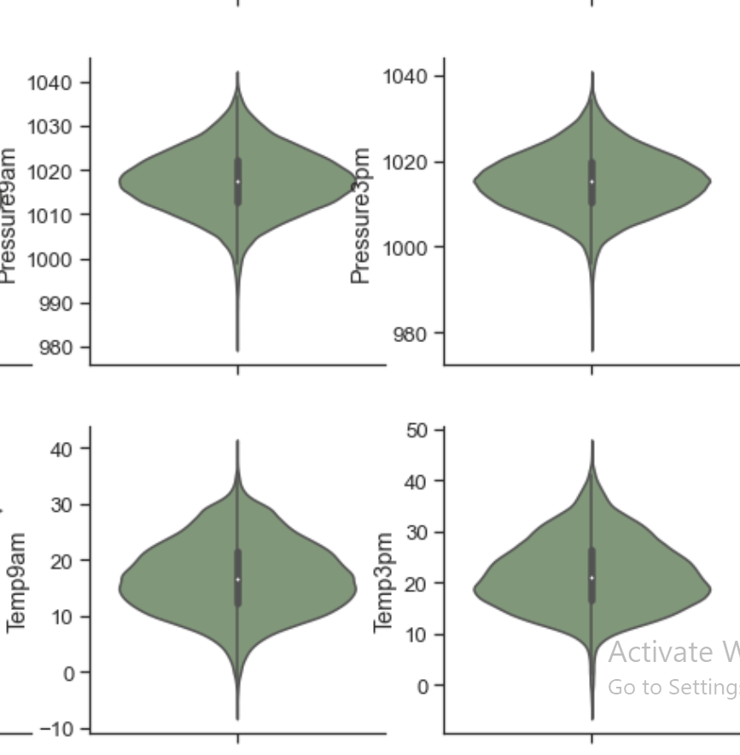
EXPLORATORY DATA ANALYSIS – Outliers

Slide 8
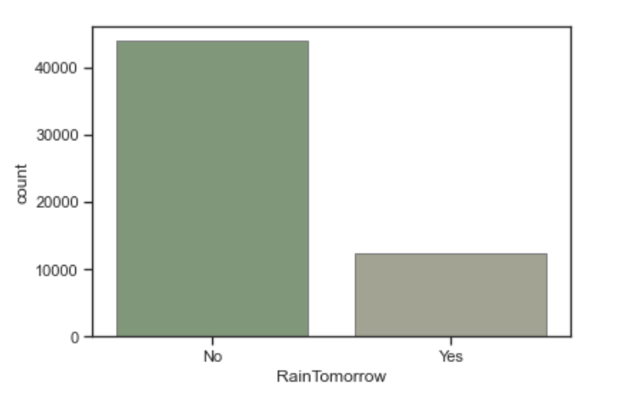
EXPLORATORY DATA ANALYSIS
No Rain Tomorrow : Rain Tomorrow :
43993 rows 78% 12427 rows 22%

Slide 9
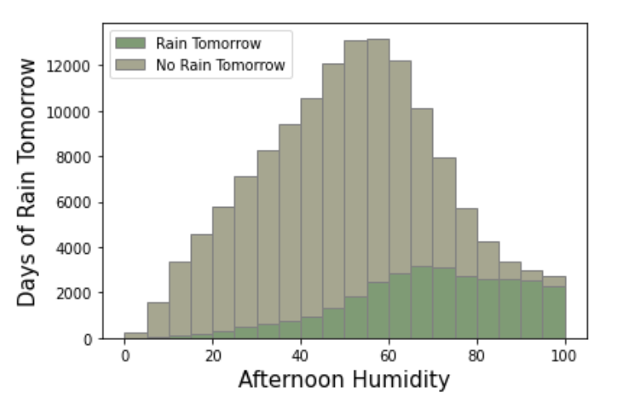
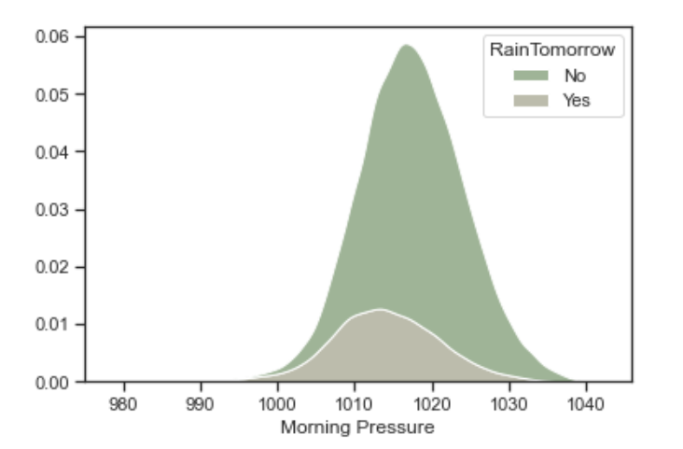
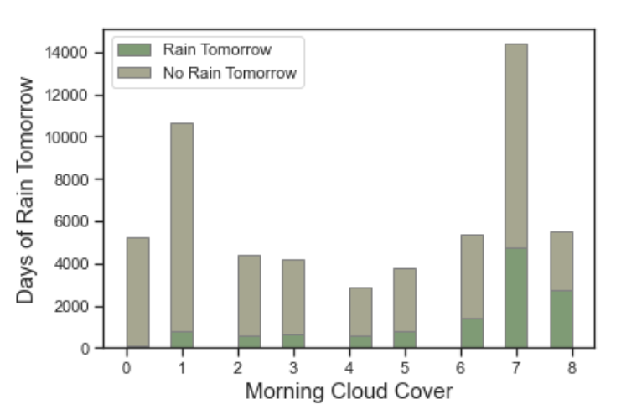
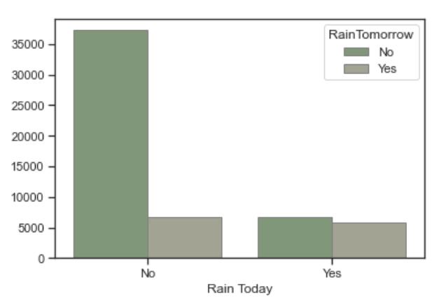
EXPLORATORY DATA ANALYSIS
More chance of rain tomorrow when humidity is high today
More chance of rain tomorrow when atmospheric pressure is ~1015 today
More chance of rain tomorrow when cloud cover is 7 or 8 oktas today
More chance of rain tomorrow when it has rained today

Slide 10
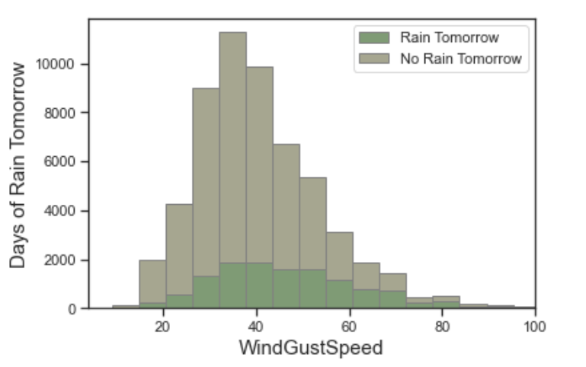
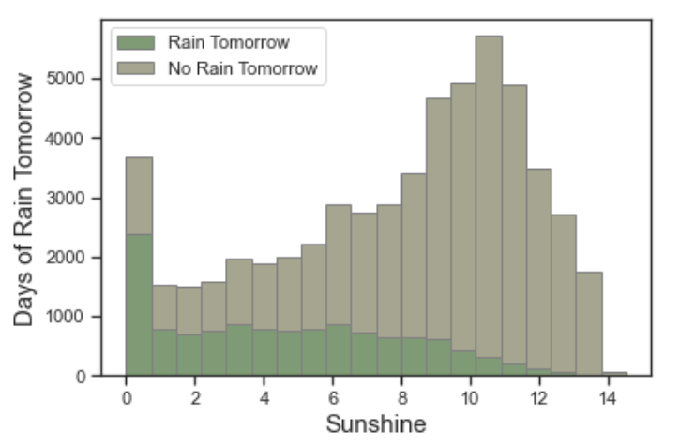
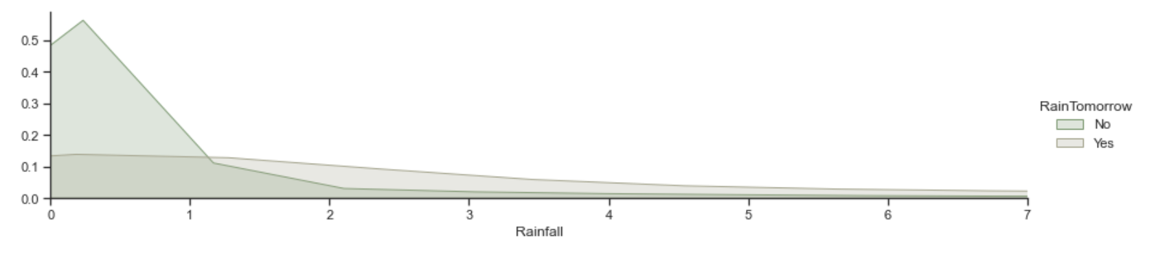
EXPLORATORY DATA ANALYSIS
More chance of rain tomorrow when wind speed is higher today
More chance of rain tomorrow when there is little sunshine today
More chance of rain tomorrow when it has rained today and the rainfall today is higher

Slide 11
DATA PREPROCESSING
01
Feature Transformation
Scaling all Numerical Columns using RobustScaler
02
Feature Extraction
Label Encoding of Target
One Hot Encoding of Categorical Features
03
Feature Engineering
Added a month column from the Date column as there are certain months that have more rain than others
04
Feature Selection
Removed 2 features due to eliminate multicollinearity

Slide 12
BASELINE MODEL
Logistic Regression
Accuracy : 85%
F1 Score : 61%
Precision :87%
(Major Class )
Precision :72 %
(Minor Class )
Recall :94%
(Major Class )
Recall :52%
(Minor Class )
Training Accuracy :85%
Test Accuracy :85%

Slide 13
MULTIPLE MODELS
Logistic KNN SVM RF XGBoost MLP
Accuracy : 85 % 83% 83% 86% 86% 82%
F1 Score : 61 % 58% 43% 62% 65% 60%
Precision :89 % 87% 83% 87% 89% 89%
(Major Class )
Precision :76 % 65% 86% 77% 74% 67%
(Minor Class )
Recall :95 % 92% 98% 95% 94% 89%
(Major Class )
Recall :57 % 53% 28% 51% 58% 61%
(Minor Class )

Slide 14
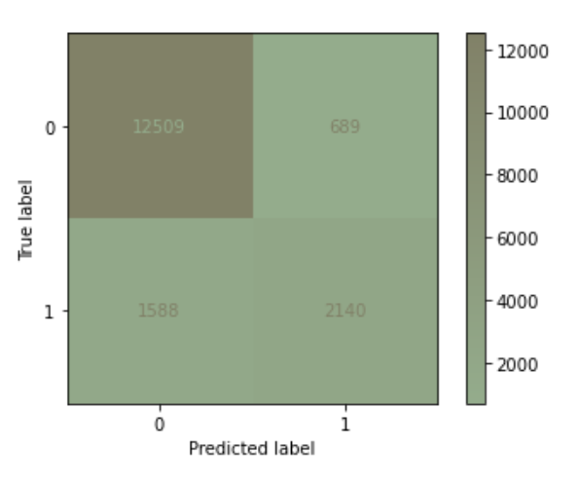
XGBOOST
Metrics
Accuracy : 85%
F1 Score : 61%
Precision :89%
(Major Class )
Precision :76 %
(Minor Class )
Recall :95%
(Major Class )
Recall :57%
(Minor Class )
Training Accuracy :92%
Test Accuracy :87%

Slide 15
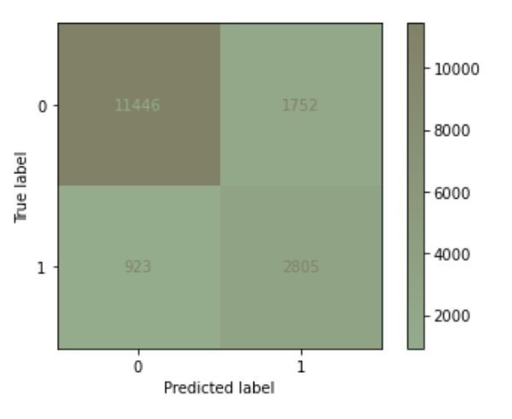
HYPERPARAMETER TUNING FOR XGBOOST
Metrics
Accuracy : 85%
F1 Score : 62%
Precision :94%
(Major Class )
Precision :62 % 14%
(Minor Class )
Recall :75%
(Major Class )
Recall :62% 5%
(Minor Class )
Training Accuracy :92%
Test Accuracy :87%
learning_rate : 0.1
max_depth : 8
reg_lambda : 1.0
gamma : 1.5
scale_pos_weight : 3

Slide 16
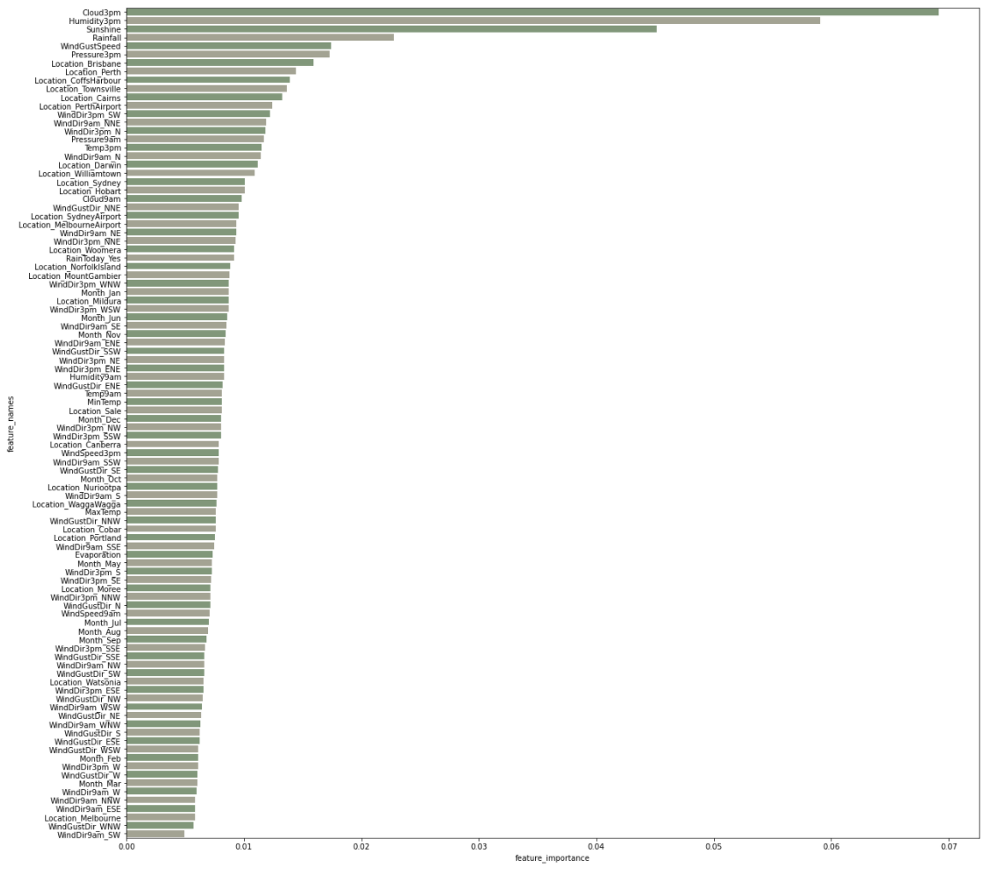
FEATURE SELECTION
Feature Importance

Slide 17
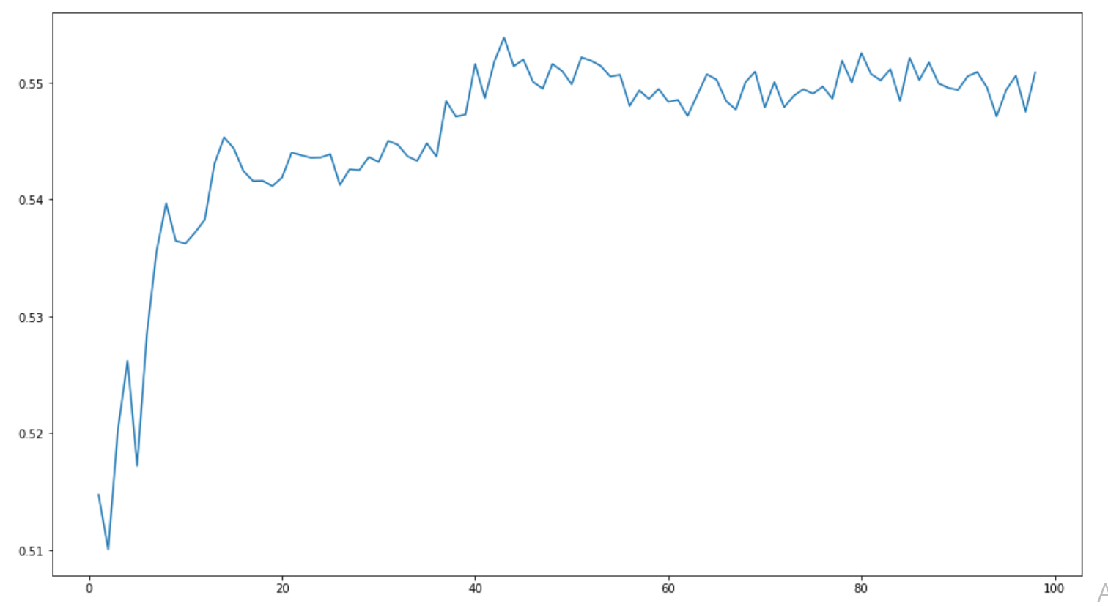
FEATURE SELECTION
Recursive Feature Elimination with Cross Validation
rfecv.n_features_ = 43

Slide 18
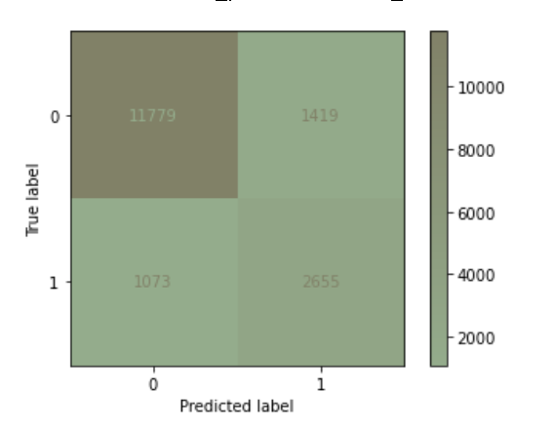
XGBOOST WITH FEATURE SELECTION
Metrics
Accuracy : 85%
F1 Score : 68%
Precision :92%
(Major Class )
Precision :65% 3%
(Minor Class )
Recall :89%
(Major Class )
Recall :71% 9%
(Minor Class )
Training Accuracy :96%
Test Accuracy :85%
learning_rate : 0.1
max_depth : 11
reg_lambda : 5.0
gamma : 0.5
scale_pos_weight : 3

Slide 19
HANDLING IMBALANCED DATASET - SMOTE
SMOTE Strategy – Over and Under Sampling
Oversample Minor Class and Undersample Major Class
Increase Minor Class to 70% of Major Class
Decrease Major Class to 10 % more than Minor Class
Major Class : Minor Class
1 : 0.9
 | Rain Tomorrow | No Rain Tomorrow
Before SMOTE | 12427 (22%) | 43993 (78%)
After SMOTE | 21556 (47%) | 23951 (53%)

Slide 20
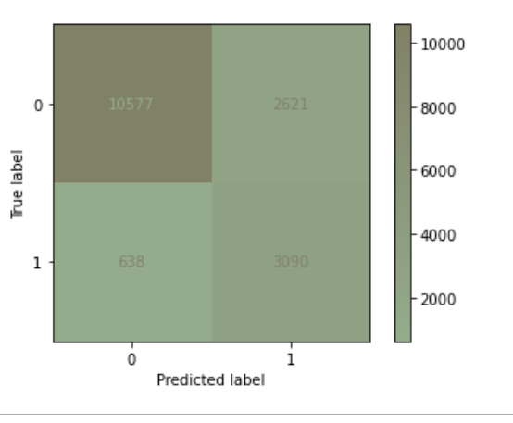
XGBOOST WITH FEATURE SELECTION AND SMOTE
Metrics
Accuracy : 85%
F1 Score : 69%
Precision :94%
(Major Class )
Precision :54% 11%
(Minor Class )
Recall :80%
(Major Class )
Recall :83% 11%
(Minor Class )
Training Accuracy :91%
Test Accuracy :81%
learning_rate : 0.1
max_depth : 8
reg_lambda : 1.0
gamma : 1.5
scale_pos_weight : 3

Slide 21
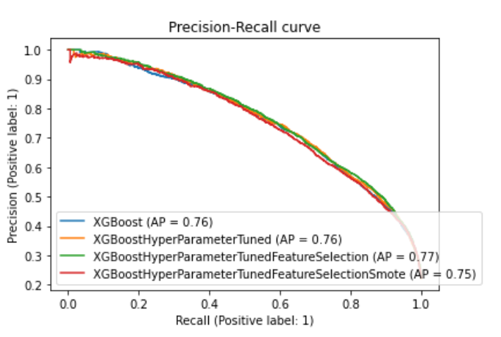
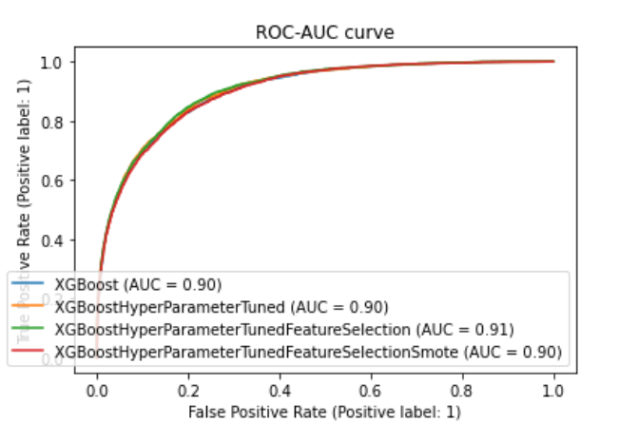
PR CURVE AND ROC-AUC CURVE
Precision-Recall
ROC-AUC

Slide 22
MORE FEATURE ENGINEERING
Used ExtraTreesClassifier and Information Gain for Feature Selection – reduced from 98 features to 15
Imputed Null Values using corresponding Day and Month of other years
Increased Number of rows from 56+K to 120+K
Added a new column to reflect high and low rainfall based on EDA
Applied the SMOTE over and under sampling to balance the dataset

Slide 23
SMOTE
 | Rain Tomorrow | No Rain Tomorrow
Before SMOTE | 12427 (22%) | 43993 (78%)
After SMOTE | 21556 (47%) | 23951 (53%)
Before SMOTE (After Feature Engineering) | 24961 (22%) | 87668 (78%)
After SMOTE (After Feature Engineering) | 61367 (47%) | 68185 (53%)

Slide 24
MULTIPLE MODELS
Logistic KNN SVM RF XGBoost MLP
Accuracy : 78 % 84% 79% 87% 83% 81%
F1 Score : 76 % 84% 77% 86% 79% 79%
Precision :78 % 93% 79% 88% 84% 81%
(Major Class )
Precision :78 % 78% 78% 86% 88% 80%
(Minor Class )
Recall :81 % 76% 81% 87% 90% 83%
(Major Class )
Recall :75 % 93% 76% 86% 76% 78%
(Minor Class )93

Slide 25
MULTIPLE MODELS
Logistic KNN SVM RF XGBoost MLP
Accuracy : 85 % 83% 83% 86% 86% 82%
F1 Score : 61 % 58% 43% 62% 65% 60%
Precision :89 % 87% 83% 87% 89% 89%
(Major Class )
Precision :76 % 65% 86% 77% 74% 67%
(Minor Class )
Recall :95 % 92% 98% 95% 94% 89%
(Major Class )
Recall :57 % 53% 28% 51% 58% 61%
(Minor Class )

Slide 26
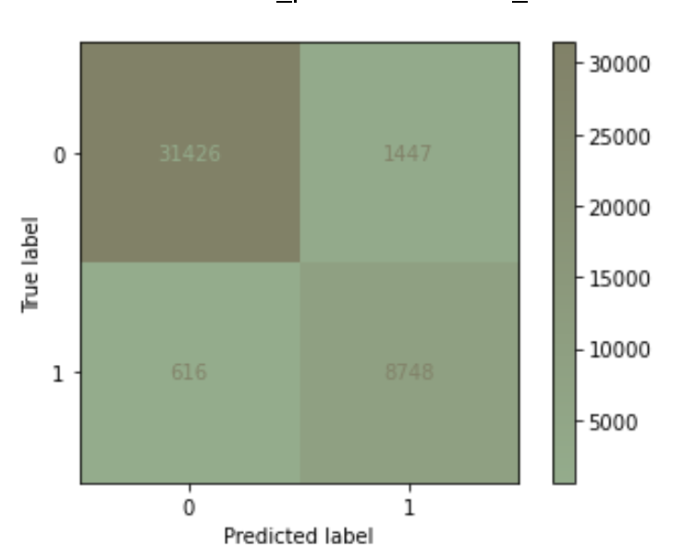
HYPERPARAMETER TUNING FOR RANDOM FOREST
Metrics
Accuracy : 88%
F1 Score : 87%
Precision :89%
(Major Class )
Precision :87 % 22%
(Minor Class )
Recall :88%
(Major Class )
Recall :87% 16%
(Minor Class )
Training Accuracy :95%
Test Accuracy :95%
n_estimators : 500
max_features : ‘auto’
min_samples_split :2
min_samples_leaf :4
max_depth: 35
criterion: ‘entropy

Slide 27
IMPROVEMENTS
Handle Outliers (True outliers vs Errors, IQR)
More feature engineering e.g. Seasons, combining features
Time series forecasting (e.g. predict rainfall over a longer period of time and predicting rain next week instead of tomorrow)

Slide 28
THANK YOU

